Slide 1
An Update on Telemarketing Laws and Agency Rules
​2024 CSPEN Annual Conference
Phoenix, Arizona
October 30, 2024

Slide 2
Thompson Coburn LLP
Full-service law firm with over 400 attorneys.
Offices in Chicago, Los Angeles, St. Louis, Dallas, New York, Birmingham, and Washington, D.C.
Higher education practice provides legal counsel, compliance, and training services to colleges and universities.

Slide 3
Presenter Profile
Roger Swartzwelder
Partner
Thompson Coburn LLP
Practice and Experience
Assists institutions of higher education in a wide array of regulatory, accreditation, and operational issues
Has substantive experience representing public, private non-profit, and proprietary institutions of higher education, investors, and accrediting agencies.
Contact Information
rswartzwelder@thompsoncoburn.com
(202) 585-6918

Slide 4
Presenter Profile
Evan Moltz
Partner
Thompson Coburn LLP
Practice and Experience
Represents educational institutions, third-party servicers, and financial investors in litigation across the country.
Has handled matters involving False Claims Act, student claims, accreditation, change in control, corporate policies, vendor disputes, and more.
Contact Information
emoltz@thompsoncoburn.com
205-504-6050

Slide 5
Conditions of Use and Disclaimer
Please note that the purpose of this presentation is to provide news and information on legal issues and all content provided is for informational purposes only and should not be considered legal advice.
The transmission of information from this presentation does not establish an attorney-client relationship with the participant. The participant should not act on the information contained in this presentation or any accompanying materials without first consulting retained legal counsel.
If you desire legal advice for a particular situation, you should consult an attorney.

Slide 6
Syllabus
Telephone Consumer Protection Act (TCPA)
Federal Trade Commission (FTC) New Recordkeeping Requirements
Federal Communications Commission (FCC) New Rule re One-to-One Consent
FCC New Rule re: Revocation of Consent
TC Extra Credit

Slide 7
Telemarketing Regulations
Telephone Consumer Protection Act (TCPA)
Enforced by Federal Communications Commission
Regulates telephone calls, text messages and faxes
Telemarketing Sales Rule (TSR)
Enforced by Federal Trade Commission
Regulates calls and text messages
CAN-SPAM Act
Enforced by FTC
Regulates commercial emails
Do Not Call
Jointly administered by FCC and FTC

Slide 8
Telephone Consumer Protection Act (TCPA)

Slide 9
Telephone Consumer Protection Act
TCPA is a 1991 federal law that is enforced by FCC
Designed to limit unwanted automated calls
Requires consent before calling/texting using autodialer or an artificial or prerecorded voice
Level of consent depends on purpose of contact
Marketing, informational, emergency calls/texts
$500 minimum penalty for each unlawful call or text
Over 400 reported TCPA opinions in 2023 alone
Class action TCPA litigation is extremely costly

Slide 10
Autodialer and Artificial or Prerecorded Voice
Consent needed for calls/texts using “automatic telephone dialing system” (autodialer) or “artificial or prerecorded voice”
Autodialer:
A device that has the capacity to store or dial phone numbers using a random or sequential number generator
Many modern dialing platforms can be considered autodialers
Best practice: assume platform is autodialer and get consent!
Artificial or Prerecorded Voice
AI-generated voice – “artificial”
Soundboard technology – prerecorded
Recorded voicemails left by live agent – prerecorded

Slide 11
Marketing Calls/Texts – Prior Express Written Consent
Schools need prior express written consent to place automated calls/texts that constitute “telemarketing”
“Telemarketing means the initiation of a telephone call or message for the purpose of encouraging the purchase or rental of, or investment in, property, goods, or services”
Examples: School wants to call/text:
Prospective student about interest in enrollment
Current student about advanced degree program
Alumni about sale at campus bookstore

Slide 12
Marketing Calls/Texts – Written Agreement
Prior express written consent means a written agreement that:
Clearly authorizes call/text to be placed using autodialer or artificial or prerecorded voice;
Includes signature of person to be called;
Identifies number to be called/texted;
Contains clear and conspicuous disclosure informing consumer:
that she is authorizing automated marketing calls/texts; and
that she is not required to agree to receive calls/texts as condition of purchasing good or service

Slide 13
Marketing Calls/Texts – Signature
FCC guidance says that a “written agreement” may be “obtained via an email, website form, text message, telephone keypress, or voice recording”
However, Federal Trade Commission, which regulates telemarketing under the Telemarketing Sales Rule (“TSR”), takes a different position:
FTC: “The Commission reiterates that a seller or telemarketer may not use an oral recording of consent for any provision of the TSR that requires consent to be provided in writing”
Schools should not rely on “voice recording” or oral consent and instead should obtain written consent for marketing calls/texts

Slide 14
Marketing Calls/Texts – Webform Agreement
“Courts have found that a person can provide prior express [consent] by submitting a web form with personal information when the web form includes a notice that the person agrees to be contacted.” Barton v. Delfgauw, 2023 WL 1818134, at *3 (W.D. Wash. Feb. 7, 2023)
“Prior express consent may be obtained via a website form.” Chladni v. Univ. of Phoenix, Inc., 2016 WL 6600045, at *2 (E.D. Pa. Nov. 7, 2016)

Slide 15
Marketing Calls/Texts – Clear and Conspicuous Disclosure in Webform
FCC: “Clear and conspicuous” means “notice that would be apparent to a reasonable consumer”
“The mere presence of this disclosure on the webpage is insufficient to establish that the website ‘reasonably notified the user’ of the terms.” Gaker v. Citizens Disability, 654 F. Supp. 3d 66, 76 (D. Mass. 2023)
Disclosures “must be displayed in a font size and format such that the court can fairly assume that a reasonably prudent Internet user would have seen it.” Berman v. Freedom Financial Network, 30 F.4th 849 (9th Cir. 2022)

Slide 16
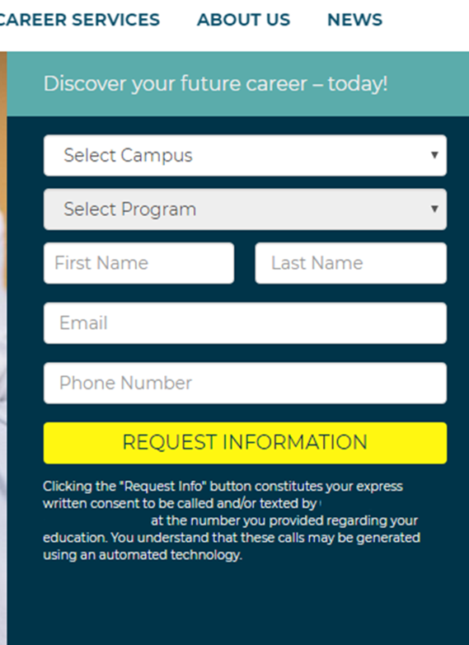
Not Clear and Conspicuous
The notice that clicking constitutes express written consent is below the “Request Information” button
“A consumer is less likely to be bound to terms agreed to on the internet where the terms were located below the ‘accept’ or ‘submit’ button or were otherwise hidden or difficult to access.” Gaker v. Citizens Disability, 654 F. Supp. 3d 66, 75 (D. Mass. 2023)
Because English speakers read left-to-right and top-to-bottom, the notice is not “unavoidable” prior to clicking the button

Slide 17
What Else Is Missing?
No disclosure that consent to receive calls/texts is not a condition of purchasing any goods or services
No disclosure that individual may receive calls placing using “artificial or prerecorded voice”

Slide 18
Clear and Conspicuous – An Example
By clicking Agree below I am providing my electronic signature and express written consent agreement to permit School Name, and parties calling on its behalf, to call and text me at the number provided below for marketing purposes, including through the use of automated technology and prerecorded and/or artificial voice messages. I acknowledge my consent is not required to obtain any good or service. I can opt-out here or by contacting School Name at 987-654-3210.
My phone number at which I agree to be contacted is: 123-456-7890.
Agree

Slide 19
Informational Calls/Texts
Schools need “prior express consent” to place informational calls/texts to students using autodialer or artificial/prerecorded voice
Consent can be oral or written
Can be obtained when student enrolls and provides contact information
Calls/texts must be “closely related” to student’s education
Examples: Student surveys, class assignments, tuition/fee charges, school activities
Do not send “dual purpose” marketing and informational calls/texts

Slide 20
Informational Calls/Texts
FCC “encourages schools to disclose the full range of all potential calls and messages that student should expect to receive when requesting consent from students”
Informational calls/texts are rarely litigated

Slide 21
Emergency Calls/Texts
Schools can always place automated calls/texts in emergencies without consent
FCC guidance:
“We confirm that autodialed calls to wireless numbers made necessary by a situation affecting the health and safety of students and faculty are made for an emergency purpose. In such situations, autodialed calls made by school callers do not require consent pursuant to the TCPA’s ‘emergency purpose’ exception”
Examples: Weather closures, unexcused student absences, danger or threat due to fire, dangerous persons, health risks

Slide 22
National Do-Not-Call Registry and EBR
Students who place phone number on national do-not-call list may still be contacted by school based on the existence of:
“Prior express invitation or permission”; or
“Established business relationship” (“EBR”)
EBR can be formed by:
“A voluntary two-way communication between a person or entity ... on the basis of a purchase or transaction with the entity within the 18 months prior to date of call”; or
An individual’s “prior inquiry or application regarding products or services offered by the entity within the three months immediately preceding the date of the call”

Slide 23
FCC – New Rule on One-to-One Consent

Slide 24
New FCC Rule re “One-to-One Consent”
FCC new rule requires “one-to-one consent”
For “prior express written consent” to be valid under new rule, an individual may only provide consent to receiving a call or text from one seller at a time
FCC is seeking to “close lead generator loophole”
“Lead-generated communications are a large percentage of unwanted calls and texts and often rely on flimsy claims of consent to bombard consumers with unwanted robocalls and robotexts”
One-to-one consent rule is effective January 26, 2025

Slide 25
What is the “Lead Generator Loophole”
Lead Generator Website:
Operates website where consumers consent to receive calls and emails about job opportunities – e.g., www.findmydreamjob.com
Consumers consent to be contacted by “Marketing Affiliates”
Marketing Affiliates are listed on separate page via hyperlink
Consent Transfer:
Lead generator “transfers” consent to Marketing Affiliates, often through or one more intermediaries
Calls: Dozens of Marketing Affiliates contact individual about interest in educational programs, resulting in hundreds of calls about topic individual did not agree to be contacted about

Slide 26
Closing the Loophole
FCC: “With this requirement we make it clear that sharing lead information with a daisy-chain of ‘partners’ is not permitted”
“If the comparison-shopping website seeks to obtain prior express written consent from multiple sellers, the webpage must obtain prior express written consent separately for each seller”

Slide 27
Closing the Loophole
Example of what is prohibited under new rule:
I agree to be contacted by Marketing Partners
Cannot hyperlink to separate page listing the Marketing Partners
Example of what is allowed under new rule:
I agree to be contacted by each of the individual entities:
Thompson Coburn Institute
CSPEN Cosmetology School
Phoenix Art Academy

Slide 28
“Logically and Topically” Related
FCC: “The content of the ensuing robotexts and robocalls must be logically and topically associated with the website where the consumer gave consent”
Example: Schools cannot rely on consent obtained via lead generator’s website that provides consumers with information about potential employment opportunities
Institutions can obtain valid consent via lead generator website providing information about educational programs

Slide 29
Vicarious Liability for Invalid Consent
Courts routinely hold sellers and telemarketers liable for calls/texts if consent obtained through lead generator is invalid
Theories of vicarious liability:
Express agency relationship
Apparent authority
Ratification
“A subagency theory has been recognized as a valid basis for imposing vicarious liability in TCPA litigation.” Hossfield v. Allstate, 2024 WL 1328651 (N.D. Ill. March 28, 2024)
Best practice: Have contracts clearly defining relationship and respective obligations with telemarketers and any lead generators

Slide 30
FCC – New Rule on Revocation of Consent

Slide 31
FCC New Rule – Revocation of Consent
New FCC rule means schools cannot limit the method by which students can revoke consent to receive automated calls or texts
Example: If a caller “requires the consumer to fax his or her revocation,” it “materially diminishes the consumer’s ability to revoke” consent
FCC: “Allowing callers to limit revocation requests only to the specific means that they have designated potentially places a significant obstacle in the way of consumers who no longer wish to receive such calls by limiting the methods available to revoke consent”

Slide 32
Revocation via “Any Reasonable Method”
Consumer can revoke consent via “any reasonable method” that “clearly expresses a desire to not receive further calls or texts”
Certain methods are “per se” reasonable:
Phone call with live operator
Automated, interactive voice or key press-activated opt-out
Website
Text message – Automatic revocation when certain words texted:
STOP, END, QUIT, REVOKE, OPT-OUT, CANCEL, UNSUBSCRIBE
“Callers may not infringe on [revocation] right by designating an exclusive means to revoke consent that precludes the use of any other reasonable method”

Slide 33
Timing to Honor Revocation Request
Current rule requires callers honor revocation request within 30 days
Must place them on internal do-not-call list
Cannot contact them for 5 years from date of request
New rule requires honoring request within 10 business days
Same 5-year do-not-call period applies
Best practice: FCC says stop contacting them “as soon as practicable”

Slide 34
Scope of Revocation Request
A consumer’s revocation request does not necessarily apply to all automated calls and texts
Consumers often consent to receive different categories of automated calls/texts – marketing and informational
Nuances in new rule requires careful review of facts

Slide 35
Scope of Revocation Request - Example 1
School obtains prospective or current student’s consent to send marketing calls and texts
School sends marketing text
Student replies “STOP”
Can school continue to call the student for marketing purposes?
No!
FCC: “When consent is revoked in any reasonable manner, that revocation extends to both robocalls and robotexts regardless of the medium used to communicate the revocation of consent”

Slide 36
Scope of Revocation Request - Example 2
School obtains consent to place marketing and informational calls/texts
School places marketing call/text to current student
Student revokes consent to marketing call/text
Can school still place informational calls/texts?
Yes
FCC: “The rule that we codify here that requires callers to honor a revocation consent request made by any reasonable means applies only to robocalls and robotexts that the called party has received”
FCC: “When a consumer revokes consent with regard to telemarketing robocalls or robotexts, the caller can continue to ... [place] an informational call” or text

Slide 37
Scope of Revocation Request - Example 3
School obtains consent to place marketing and informational calls/texts to student
School places informational call/text to student
Student replies “STOP” and revokes consent
Can school still place marketing calls/texts?
No!
FCC: “If the revocation request is made directly in response to a ... informational call or text ... this constitutes an opt-out request from the consumer and all further non-emergency robocalls and robotexts must stop”
Note: Even emergency calls/texts must stop upon request

Slide 38
Scope of Revocation Request - Example 4
School obtains consent to place marketing calls/texts
School sends marketing text about Campaign A
Student replies “STOP” to text about Campaign A
Can school still place marketing call/text about Campaign B?
Maybe
FCC: Permits school to send a one-time confirmatory text within 5 minutes to clarify the scope of the revocation
Absent affirmative response, all marketing calls/texts must stop

Slide 39
Email Revocation - Example 5
School obtains consent to place marketing calls/texts
Student revokes consent by sending text to school
Can school still send marketing emails to student?
Yes. Emails are not subject to TCPA
Commercial emails governed by federal CAN-SPAM Act
No consent required to send marketing email
Exceptions:
If student’s call/text explicitly requests to not be contacted via email, school must stop emails
If student emails revocation request, stop emails too

Slide 40
Effective Date
FTC announced on October 11 that the new rule takes effect on April 11, 2025
Exception: one-time confirmatory text message amendment became effective in April 2024
Schools can take advantage of one-time confirmatory text now without risking violating consent rules

Slide 41
FTC – New Recordkeeping Requirements

Slide 42
FTC New Rule for Recordkeeping under Telemarketing Sales Rule
FTC enforces the Telemarketing Sales Rule (“TSR”)
New FTC rule updates recordkeeping requirements that apply to telemarketing calls under 34 CFR § 310.5
Current rule requires sellers and telemarketers to retain certain records for 2 years
Under new rule, records now must be retained for 5 years
Sellers and telemarketers can agree to allocate responsibility for recordkeeping

Slide 43
Updated Recordkeeping Requirements
Sellers/telemarketers must retain following records for 5 years:
Each unique telemarketing script, brochure, advertising, promotional material, and prerecorded message used
Call detail records for each telemarketing call under 16 CFR 310.5(a)(2)
Name of telemarketer
Name of seller on whose behalf call is placed
Good or service that is subject of call
Whether call is outbound call and uses prerecorded message
Scripts and prerecorded messages used during calls
Number called, date/time of call, duration of call, disposition of call
Caller ID information

Slide 44
Updated Recordkeeping Requirements
Record of consent obtained in same format presented to consumer
Do-not-call records
Version of national DNC registry accessed and used by sellers and telemarketers
Contract between sellers and telemarketers

Slide 45
Effective Dates
Certain parts of new FTC rule were effective May 16, 2024
Unique telemarketing scripts, advertising materials, prerecorded messages
Consent and do-not-call records
Contracts with telemarketers
Version of national DNC registry accessed
Other parts did not require compliance until October 15, 2024
“Compliance with 16 CFR 310.5(a)(2) is not required until October 15, 2024”
16 CFR 310.5(a)(2): Call detail records

Slide 46
Summary
Telephone Consumer Protection Act (TCPA)
Consent required before calling or texting using autodialer or artificial or prerecorded voice
Federal Communications Commission (FCC) New Rule re One-to-One Consent
New rule means consumers can provide consent to receive automated calls/texts from only one seller at a time
Federal Trade Commission (FTC) New Recordkeeping Requirements
New rule requires certain records be maintained for 5 years, up from 2 years
Type of consent depends on purpose of contact:
Marketing – prior express written consent
Informational – express consent (oral or written)
Emergency – no consent required
Implications for schools that obtain consent through lead generators
Effective January 26, 2025
Effective April 11, 2025
Part of rule effective May 2024, other parts effective October 2024
New rule means schools cannot limit methods by which students can revoke consent
FCC New Rule re Revocation of Consent

Slide 47
Additional Resources
FCC New Rule re: One-to-One Consent
89 Fed. Reg. 5098 (Jan. 26, 2024)
FCC New Rule re: Revocation of Consent
89 Fed. Reg. 15756 (Mar. 5, 2024)
FTC New Rule re: Recordkeeping Requirements
89 Fed. Reg. 26760 (Apr. 16, 2024)
FCC Guidance re: Schools
July 2016 Declaratory Ruling

Slide 48
Update on Telemarketing Laws
Telemarketing Laws Update provides a quick glance at new agency rules and requirements
The document is available on our Higher Education Resources page, and we are happy to provide a copy upon request (please email srichter@thompsoncoburn.com).
Notes:
EWM

Slide 49
Questions?

Slide 50
TC Extra Credit

Slide 51
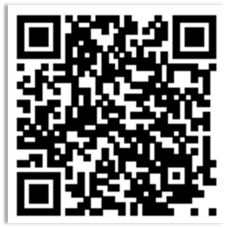
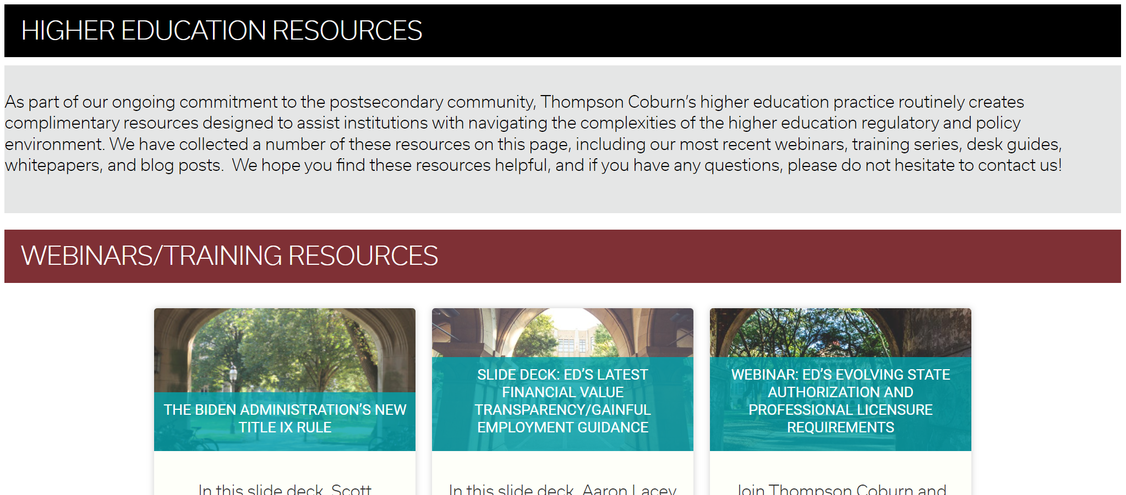
TC Extra Credit | Resources Page

Slide 52
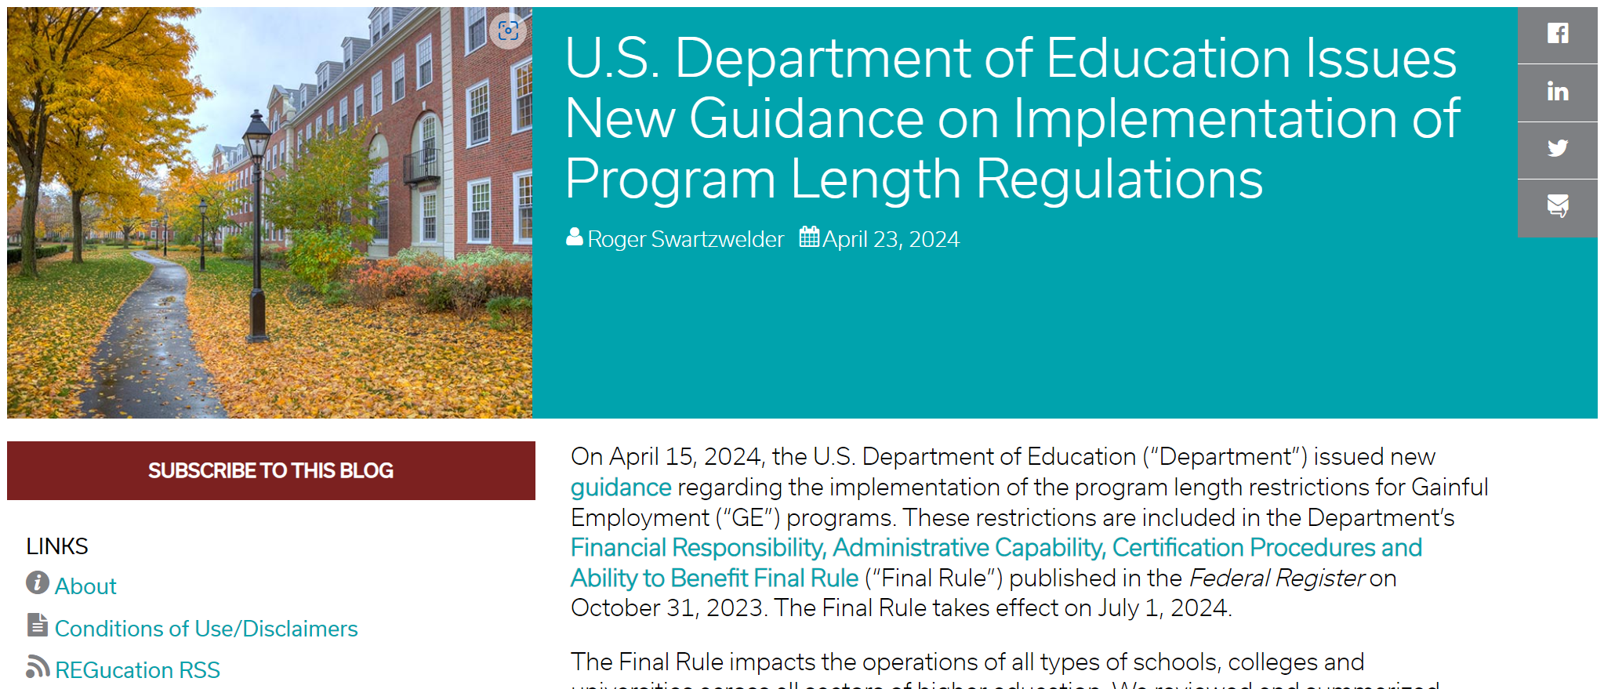
TC Extra Credit | REGucation Blog

Slide 53
TC Extra Credit | Webinars & Training Series

Slide 54
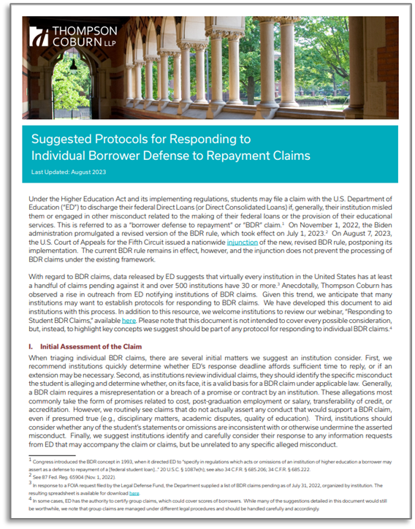
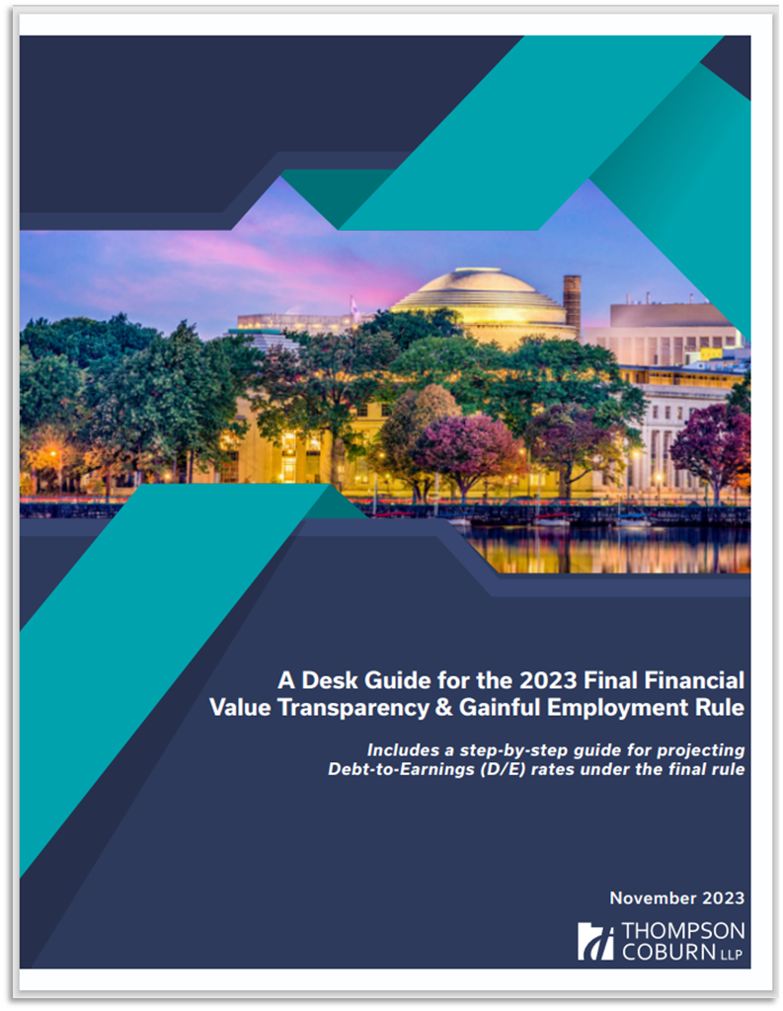
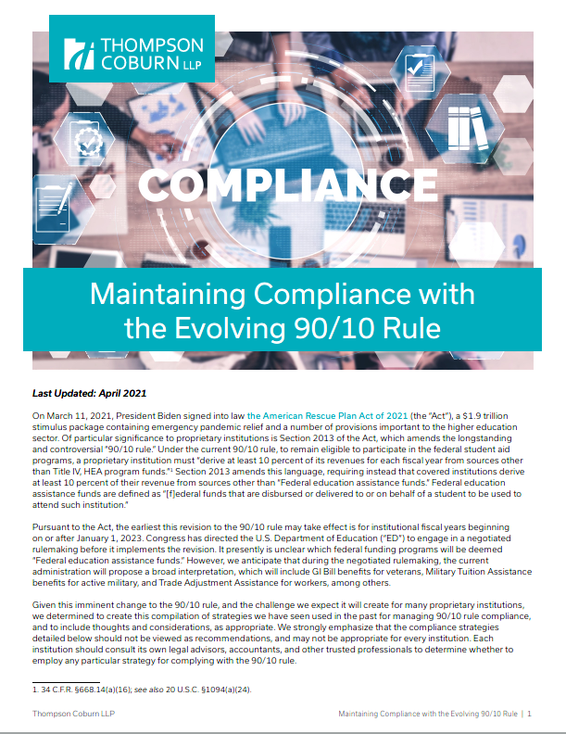
TC Extra Credit | Compliance Materials

Slide 55
Case Example
“According to Franklin, DePaul sent a series of unsolicited text messages to his personal cell phone. On November 18, 2015, Franklin received an automated text message from short code #467467 to his cell phone. The text read,
“Thanks for opting in! Watch for important news/deadlines from Depaul (maximum one per week). Message and data rates apply[.] Text OUTDP to opt out.”
Franklin alleges that he never provided his cell phone number to DePaul, nor did he give prior express consent to be called. Upon receiving the initial message, he immediately responded by replying
“Out.”
DePaul’s automated system responded with:
“ShopText: Sorry we didn't understand your text. Or your session expired. Check the spelling and reply w/ the keyword. No quotes or spaces. For help, reply HELP.”
Franklin states that he sent several subsequent text messages in an attempt to stop the messaging campaign. Nevertheless, he continued to receive at least seventeen unsolicited text messages after telling DePaul to stop contacting him. He also alleges that he continues to receive such text messages to the present day. Based on these facts, Franklin claims that DePaul violated the TCPA.”

Slide 56
Case Example – Cont.
DePaul argues that Franklin’s allegations fail to state a claim because he gave prior express consent to receive the text messages in question. According to DePaul, it is clear from the fact that the initial text message read “Thanks for Opting In!” that “[Franklin’s] phone number was ‘opted in’ to receiving text messages from DePaul.”
But Franklin explicitly states in his complaint that he “has never provided his cellular phone number to the Defendant or given his prior express consent to be called.”
DePaul seeks to bolster its argument by including an exhibit of an online form from its website, as well as an exhibit of what seems to be a series of back-end system screenshots.
DePaul’s exhibits appear to consist of screenshots of some unspecified computer program or Internet site whose accuracy has not been verified
DePaul argues that Franklin’s failure to opt out of subsequent text messages after receiving the first message shows continual express consent to receive the subsequent messages. Specifically, DePaul claims that Franklin failed to use a reasonable means available to opt out by replying with the word “Out” instead of with the keyword “OUTDP” as instructed
Drawing reasonable inferences in Franklin’s favor, it is hardly clear from the face of the complaint that he intended to give his express consent to receive further text messages by texting “Out,” instead of “OUTDP.” In fact, texting “Out” may just as well support Franklin’s opposing assertion that he intended to opt out of DePaul’s text message
Franklin v. Depaul Univ., 2017 WL 3219253 (N.D. Ill. July 28, 2017)

